Slide 1
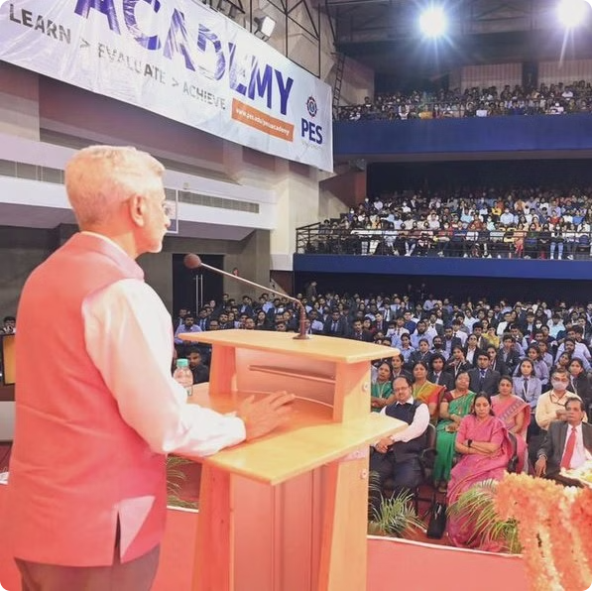



PESU
Seminar Hall Booking System
Team Members:
Sindhu Mahesh Hegde -SRN:PES1PG23CA300
Varshitha T -SRN:PES1PG23CA315
Varsha Shridhar Hegde -SRN:PES1PG23CA314

Slide 2

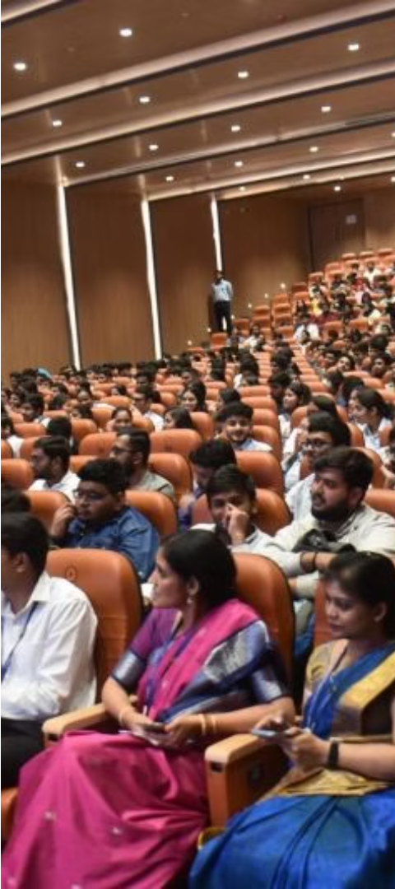
Problem Statement:
Institutions and organizations often face challenges in efficiently managing their seminar hall Resources .There is a pressing need for a modern, automated seminar hall booking system to streamline the process, enhance user experience, and optimize resource utilization.
1
Manual Booking Processes:
The current booking system relies heavily on manual processes, including phone calls, emails, or in-person inquiries, leading to inefficiencies and errors in managing bookings.
2
Limited Accessibility:
Users often face difficulties in checking the availability of seminar halls and making bookings.
3
Overbooking and Conflicts:
Without a centralized system, there is a risk of overbooking or scheduling conflicts.

Slide 3




Solution to The Problem
1.Convenient Booking
2.Streamlined Booking Process
3.Increased Utilization
The user-friendly booking system offers a seamless and convenient experience, allowing users to easily check availability, make reservations, and manage their bookings.
The enhanced user experience and improved accessibility lead to increased utilization of seminar hall resources, as users are more inclined to make bookings.
Simplifies the booking process for users and administrators, reducing manual efforts and minimizing errors

Slide 4
    1.XAMPP: It is a widely used cross-platform web server that helps developers create and test their programs on a local webserver. Developed by Apache Friends, XAMPP includes the Apache HTTP Server, MariaDB, and interpreters for programming languages like PHP and Perl.
      2.PHP : PHP is an open-source, server-side programming language that can be used to create websites, applications, customer relationship management systems and more. It is a widely-used general-purpose language that can be embedded into HTML.
      3.MySQL: MySQL creates a database that allows you to build many tables to store and manipulate data and defining the relationship between each table.
      4.HTML: HTML (Hypertext Markup Language) is a text-based approach to describing how content contained within an HTML file is structured.
Tech Used:

Slide 5
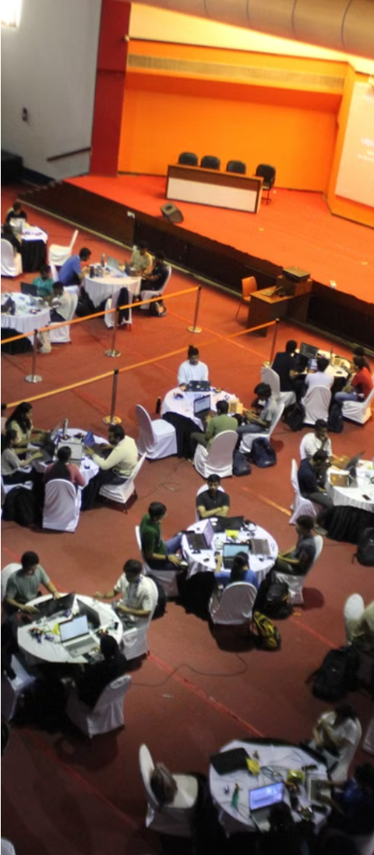






Modules Included
Halls
List of all the seminar halls in the University .
Book Hall
To book a particular hall on a scheduled date and time
(Manages conflicts).
Show Schedules
To book a particular hall on a scheduled date and time.
Cancel Booking
To cancel booked halls.
Update Booking
To update booked schedule.

Slide 6
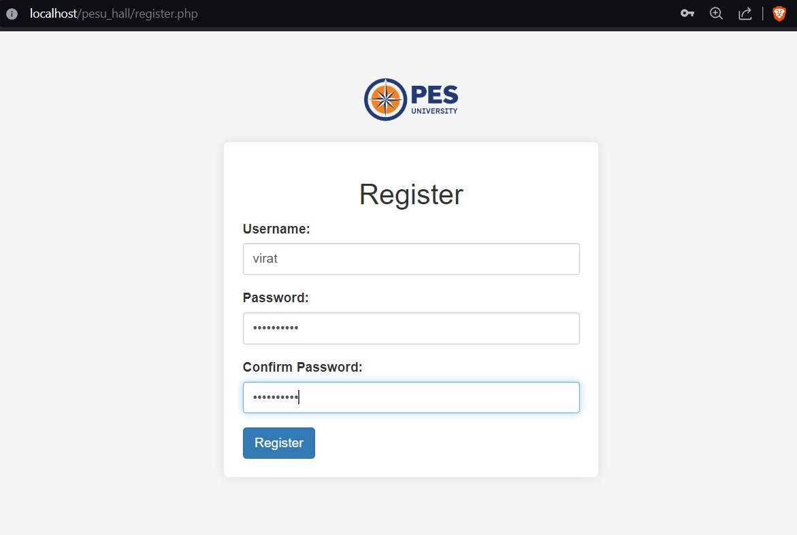
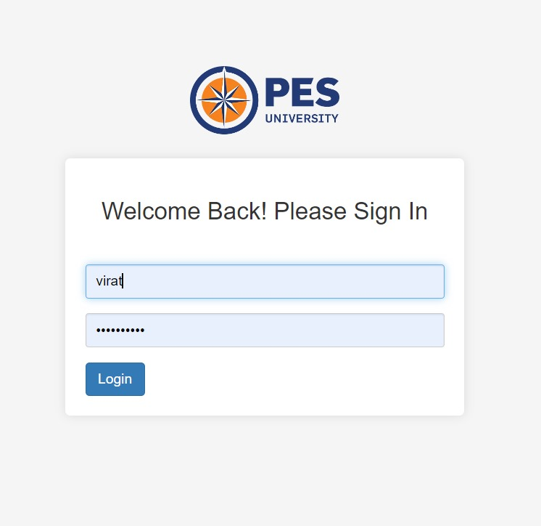
1 Register Page: 1.1 Login Page
Screenshots:

Slide 7
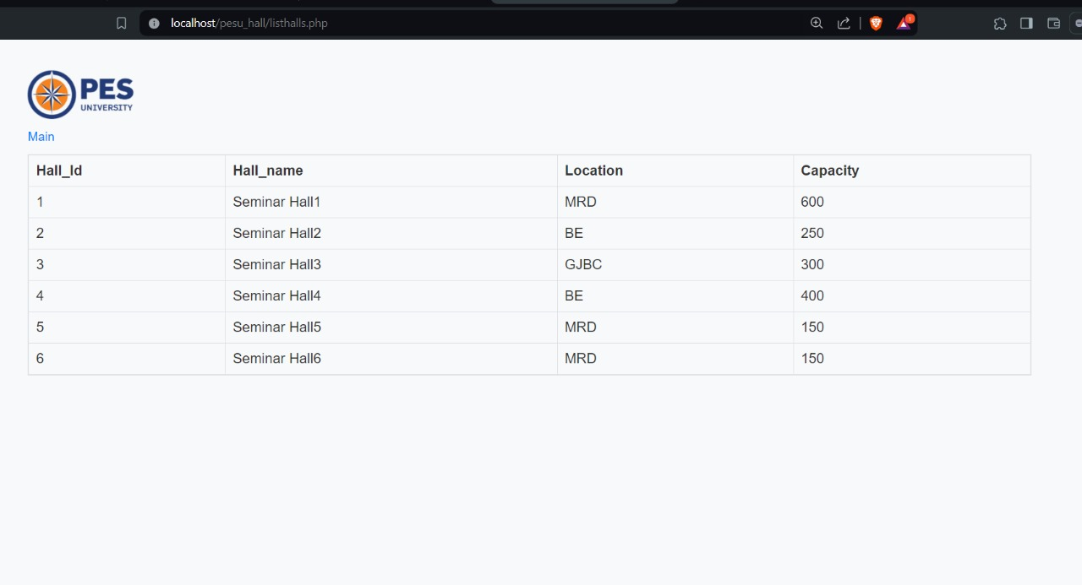
2.Halls :
2.1 Seminar Halls List:

Slide 8
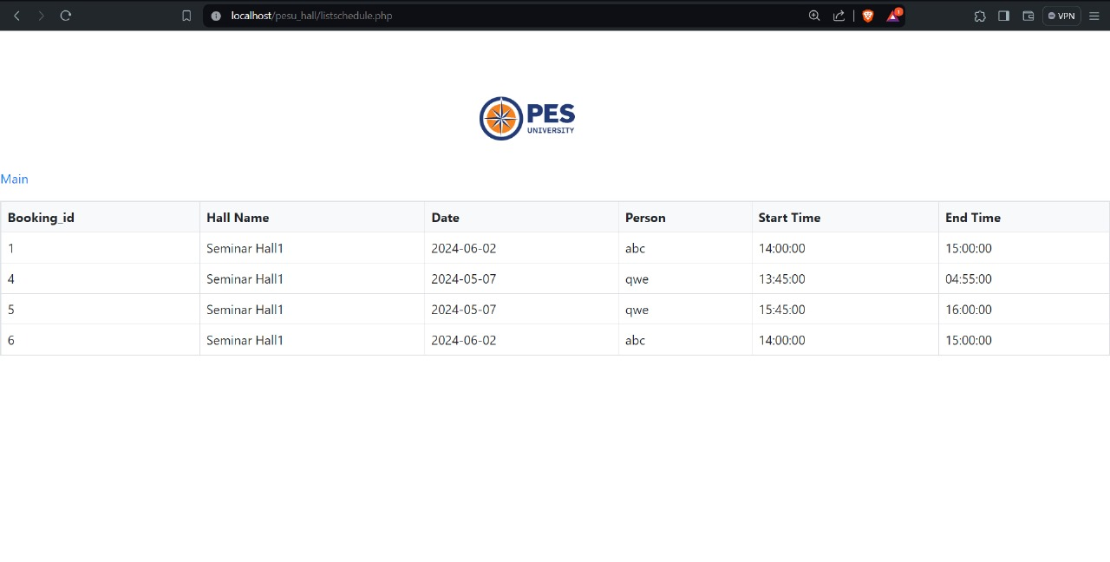
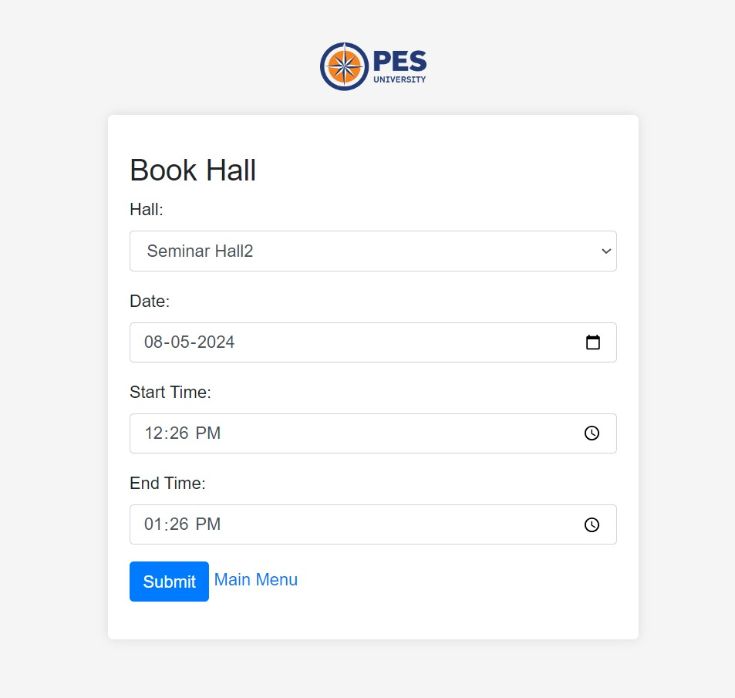
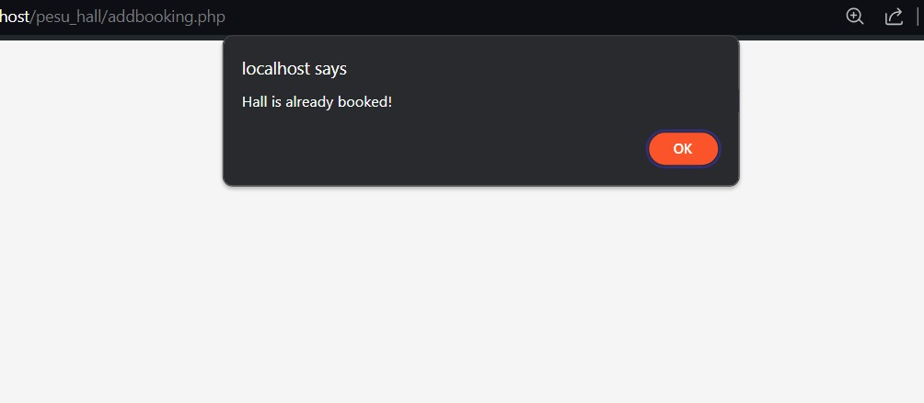
3.1 Book Hall:
3.Hall Booking: 3.2 Scheduled /booked Halls:
3.3 Conflicts handling

Slide 9
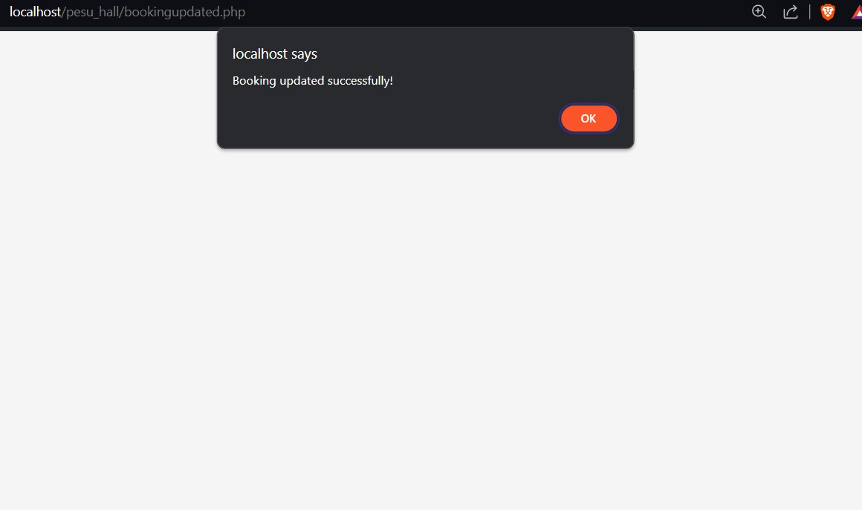
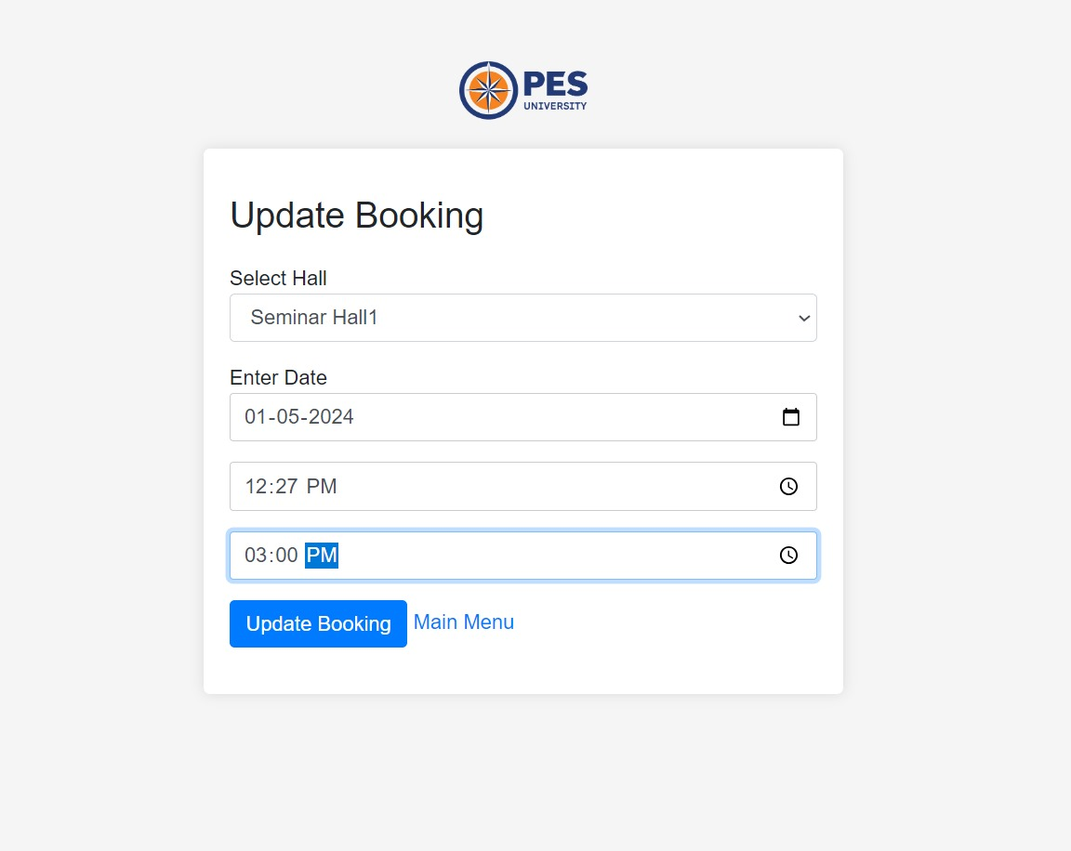
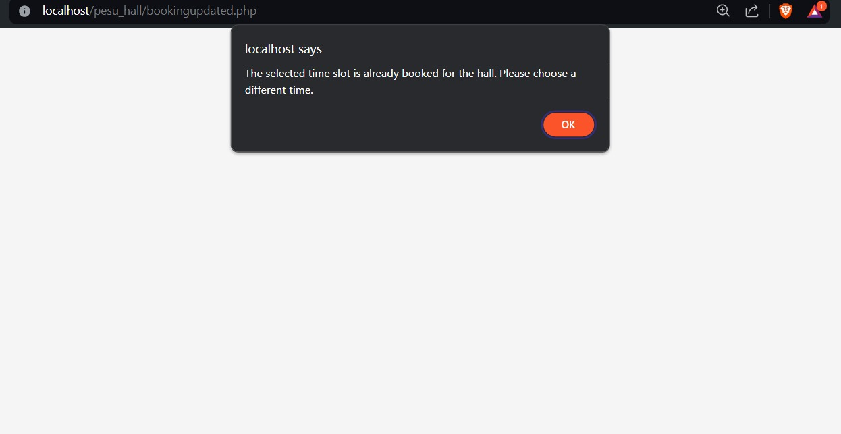
S 4.2Updated
4.1 Update Booking
    4.3 Handling conflicts if any:
4.Update Page:

Slide 10
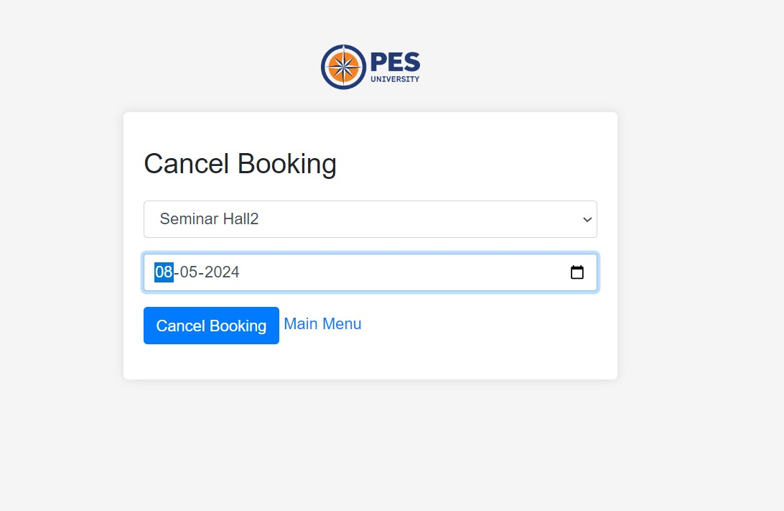
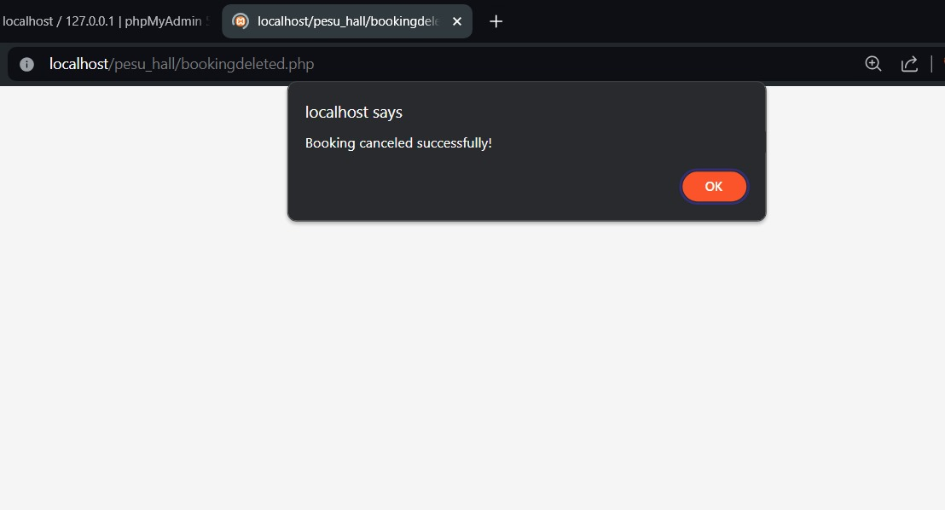
5. Booking Cancel Page:
5.1 Cancel Booking:
5.2 Booking cancelled:

Slide 11
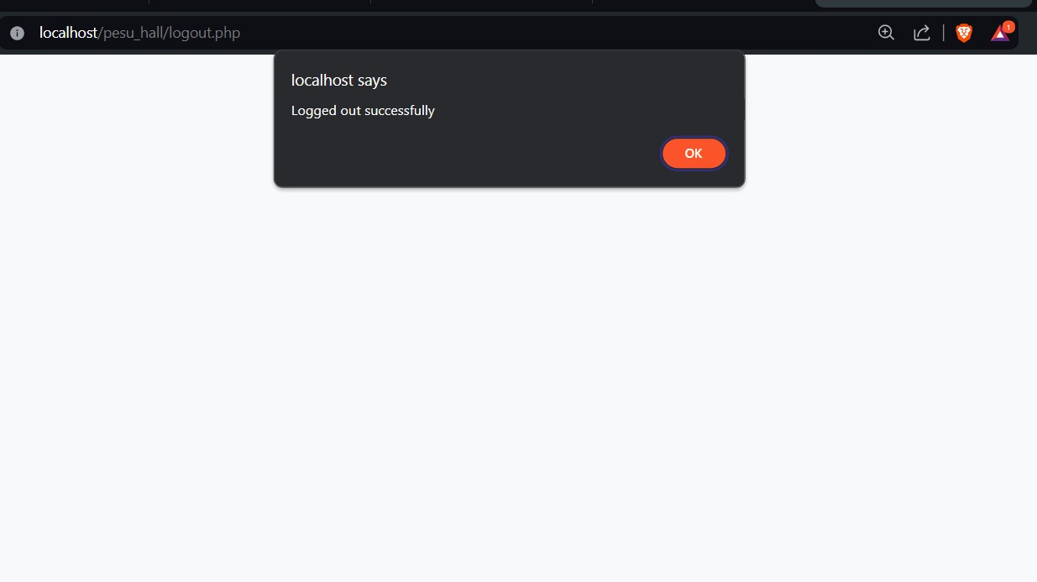
6.1 Logging out:
6.Logout Page:

Slide 12
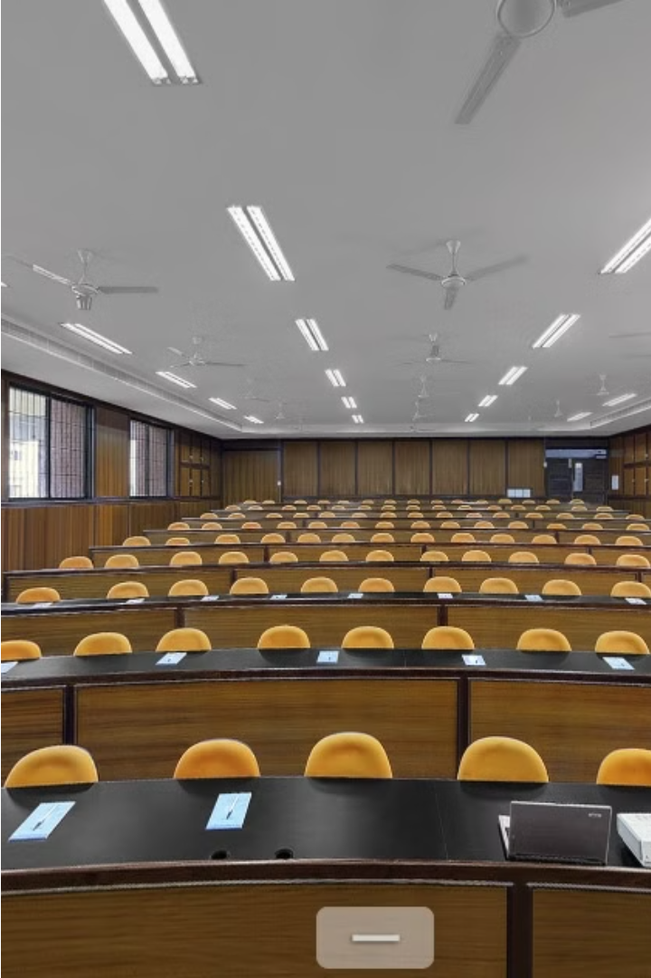
Thank You !!!

